Slide 1

Chapter 8 Image Compression
智能视觉理解
实验室

Slide 2
8.1 Fundamentals
Compression Technique:
information processing with less data representation
Information Lossless → Input = Output
Information Lossy → Input ≠ Output
Relative data redundancy:
Compression Ratio:
If b=b’, C=1, R=0, no redundancy;
If b>b’, C>1, R>0, data redundancy.

Slide 3
8.1 Fundamentals
Coding redundancy
Spatial redundancy
Irrelevant redundancy
FIGURE 8.1
Computer generated 256×256×8 bit images.

Slide 4
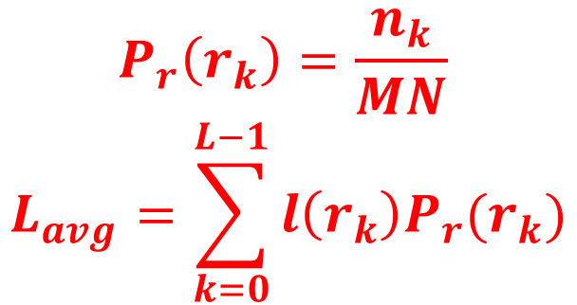


8.1.1 Coding Redundancy
TABLE 8.1
Example of variable-length coding.
$$P_{r}\left(r_{k}\right)=\frac{n_{k}}{MN}$$
$$L_{avg}=\sum_{k=0}^{L−1}{l\left(r_{k}\right)P_{r}(r_{k})}$$
$L_{avg}=$8 bits
$L_{avg}=$1.81 bits

Slide 5
8.1.2 Spatial and Temporal
Redundancy
FIGURE 8.2
The intensity histogram of the image in Fig. 8.1(b).

Slide 6
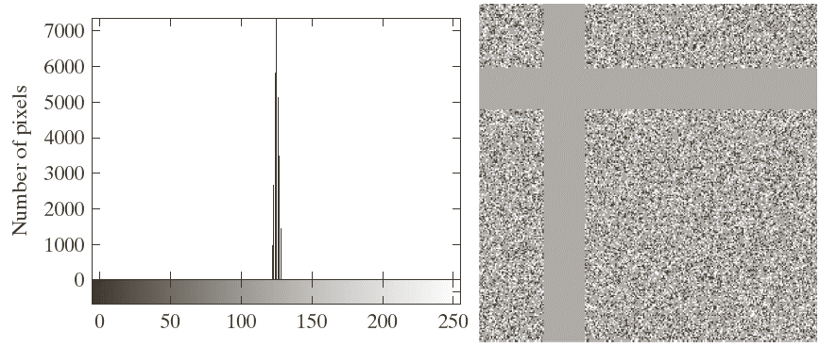
8.1.3 Irrelevant Information
Histogram of Fig. 8.1(c)
Equalized Image
FIGURE 8.3

Slide 7
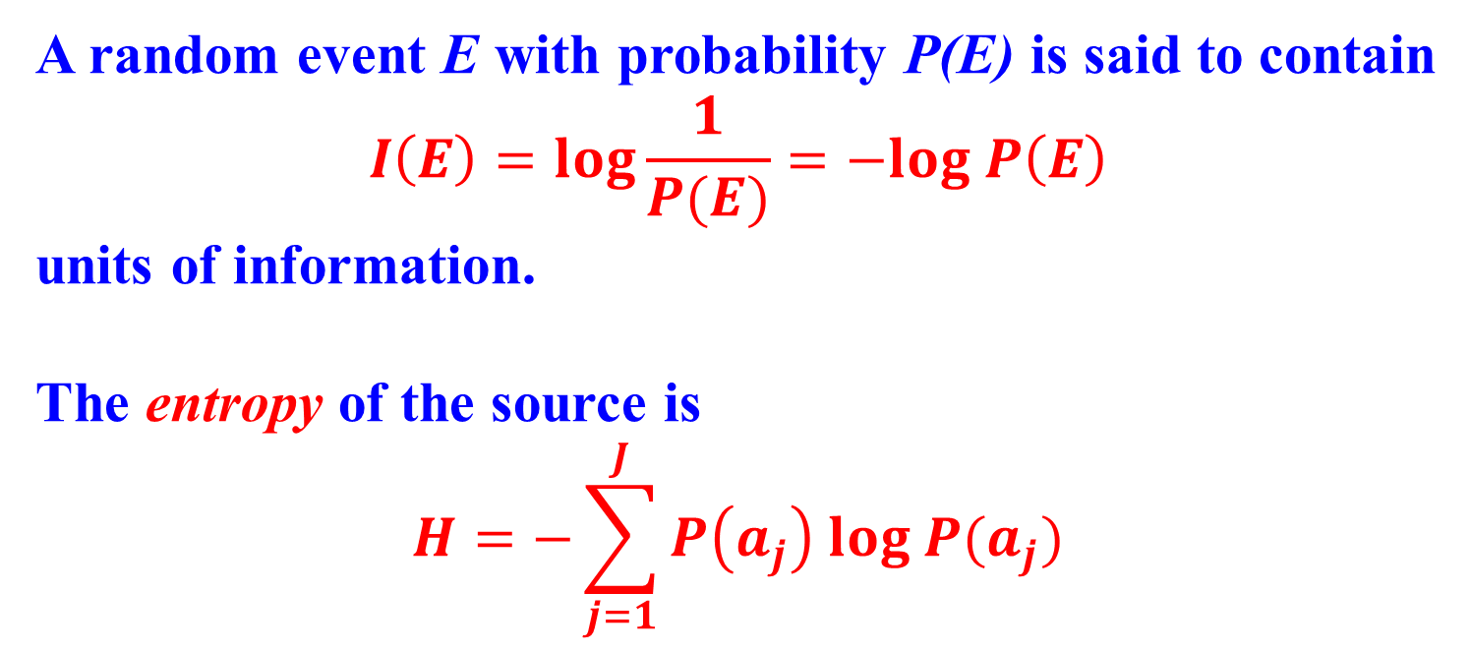
8.1.4 Measuring Image Information
A random event E with probability P(E) is said to contain
$$I\left(E\right)=log\frac{1}{P(E)}=−log P\left(E\right)$$
units of information.
The entropy of the source is
$$H=−\sum_{j=1}^{J}{P\left(a_{j}\right) log P(a_{j})}$$

Slide 8
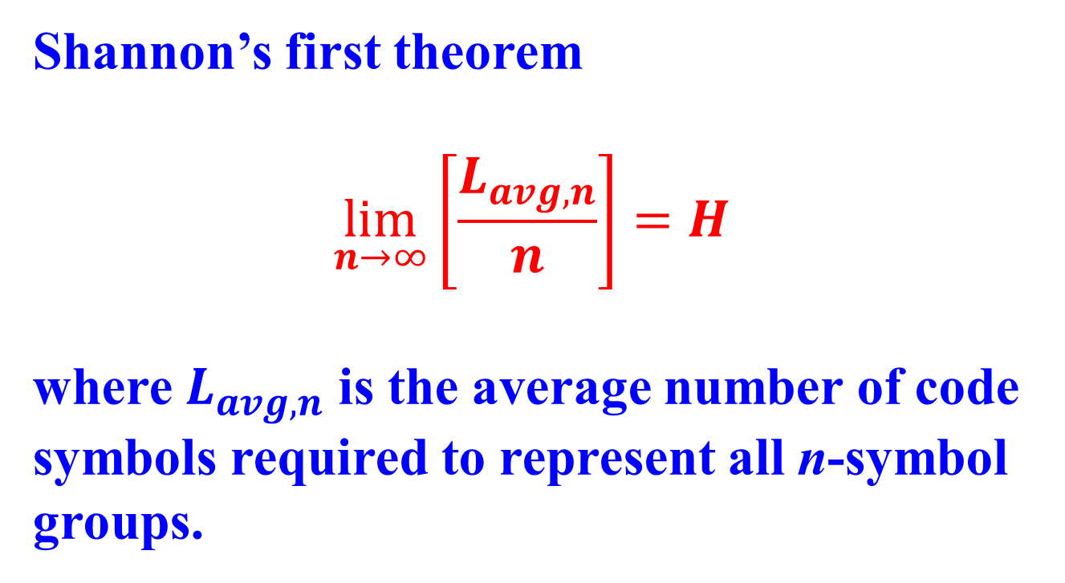
8.1.4 Measuring Image Information
Shannon’s first theorem
$$\lim_{n→∞}\left[\frac{L_{avg,n}}{n}\right]=H$$
where $L_{avg,n}$ is the average number of code symbols required to represent all n-symbol groups.

Slide 9
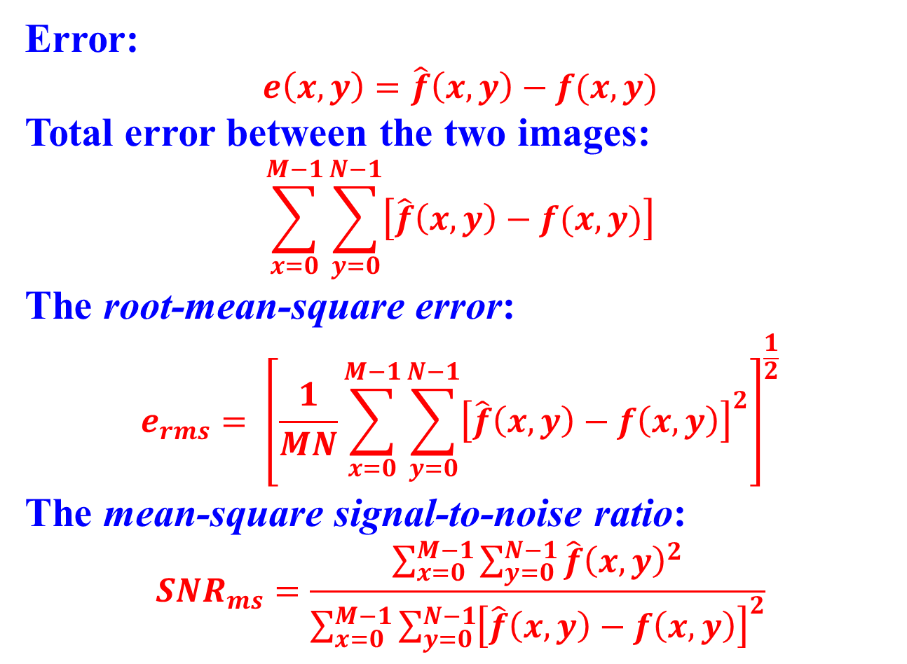
8.1.5 Fidelity Criteria
Error:
$$e\left(x,y\right)=\hat{f}\left(x,y\right)−f(x,y)$$
Total error between the two images:
$$\sum_{x=0}^{M−1}{\sum_{y=0}^{N−1}{\left[\hat{f}\left(x,y\right)−f(x,y)\right]}}$$
The root-mean-square error:
$$e_{rms}= {\left[\frac{1}{MN}\sum_{x=0}^{M−1}{\sum_{y=0}^{N−1}{{\left[\hat{f}\left(x,y\right)−f\left(x,y\right)\right]}^{2}}}\right]}^{\frac{1}{2}}$$
The mean-square signal-to-noise ratio:
$$SNR_{ms}=\frac{\sum_{x=0}^{M−1}{\sum_{y=0}^{N−1}{\hat{f}{\left(x,y\right)}^{2}}}}{\sum_{x=0}^{M−1}{\sum_{y=0}^{N−1}{{\left[\hat{f}\left(x,y\right)−f\left(x,y\right)\right]}^{2}}}}$$

Slide 10
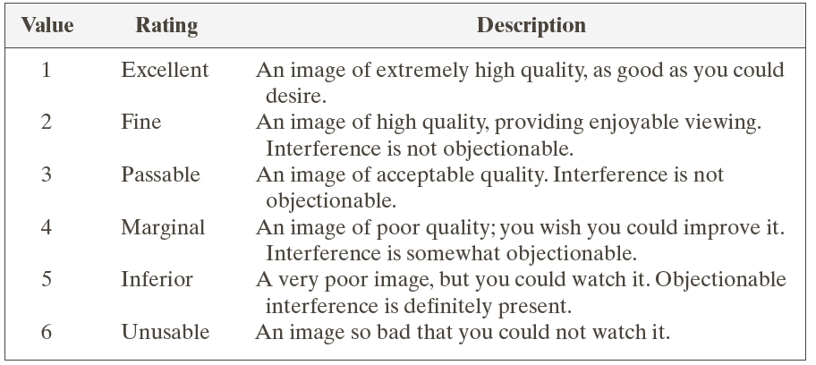
8.1.5 Fidelity Criteria
TABLE 8.2
Rating scale of the Television Allocations Study Organization.

Slide 11
8.1.5 Fidelity Criteria
RMS=5.17
RMS=15.67
RMS=14.17
Excellent
Passable/Marginal
Inferior/
Unusable
FIGURE 8.4
Three approximations of the image in Fig. 8.1(a).

Slide 12
8.1.4 Image Compression Models
FIGURE 8.5
Functional block diagram of general image compression system.

Slide 13
8.1 Fundamentals
BLACK: internationally sanctioned
FIGURE 8.6
Some popular image compression standards, file formats, and containers.

Slide 14
8.2.1 Huffman Coding
FIGURE 8.7
Huffman source reductions.

Slide 15
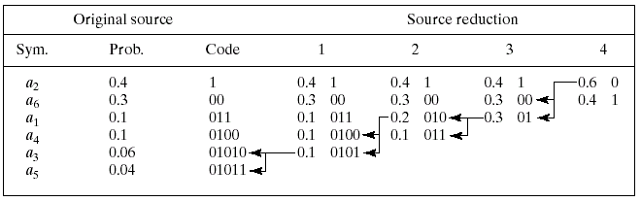
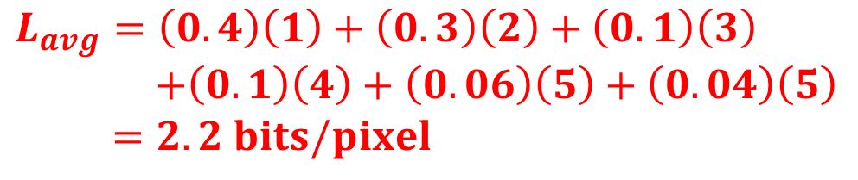
8.2.1 Huffman Coding
Huffman code assignment procedure.
FIGURE 8.8
$$L_{avg}=\left(0.4\right)\left(1\right)+\left(0.3\right)\left(2\right)+\left(0.1\right)\left(3\right)$$
$+\left(0.1\right)\left(4\right)+\left(0.06\right)\left(5\right)+\left(0.04\right)\left(5\right)$
$=2.2 bits/pixel$

Slide 16
8.2.1 Huffman Coding
A 256×256×8 bit image
Histogram
FIGURE 8.9
Huffman’s coding with 7.428bits/pixel

Slide 17
8.2.2 Golomb Coding
TABLE 8.5
Several Golomb codes for the integers 0-9.

Slide 18
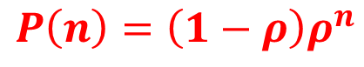
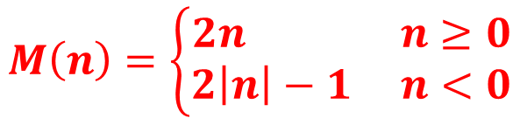
8.2.2 Golomb Coding
One-Side Geometric Distribution
Two-Side Exponentially Decaying Distribution
Reordered Version of (b)
$$M\left(n\right)=\left\{\begin{aligned}2n n≥0 \\ 2\left|n\right|−1 n<0\end{aligned}\right.$$
$$P\left(n\right)=\left(1−ρ\right)ρ^{n}$$

Slide 19
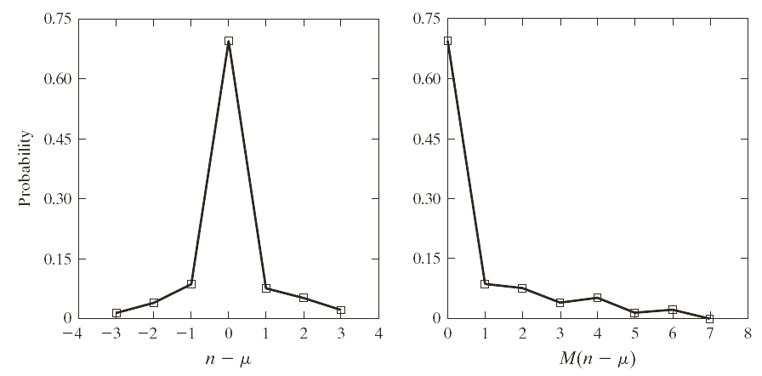

8.2.2 Golomb Coding
$$M\left(n\right)=\left\{\begin{aligned}2n n≥0 \\ 2\left|n\right|−1 n<0\end{aligned}\right.$$
FIGURE 8.11
(a) The probability distribution of the image in Fig. 8.1(c) after subtracting the mean intensity from each pixel, and (b) a mapped version of (a) using Eq. (8.2-4)

Slide 20
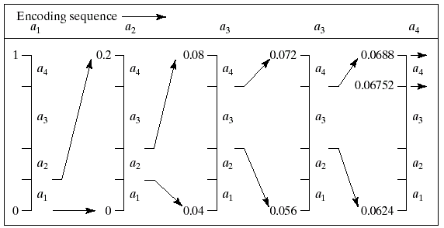
8.2.3 Arithmetic Coding
FIGURE 8.12
Arithmetic coding procedure.

Slide 21
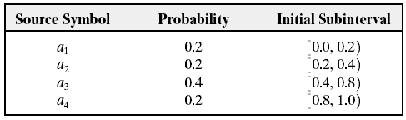
8.2.3 Arithmetic Coding
Arithmetic Coding Example
TABLE 8.6

Slide 22
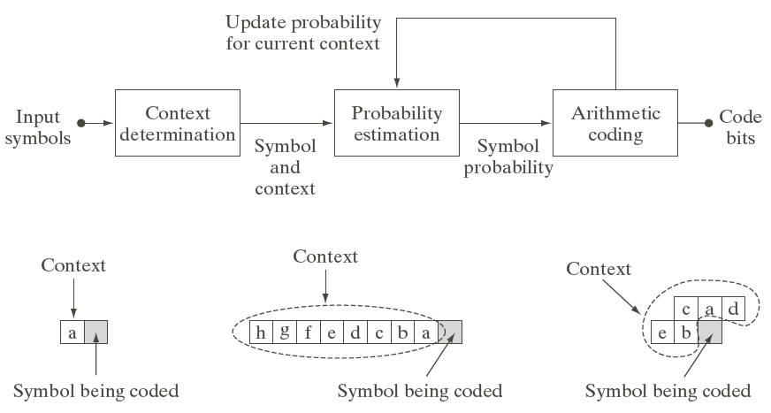
8.2.3 Arithmetic Coding
Adaptive Context-Based Arithmetic Coding Approach
Three Possible Context Models

Slide 23
8.2.4 LZW Coding
EXAMPLE: LZW Coding

Slide 24
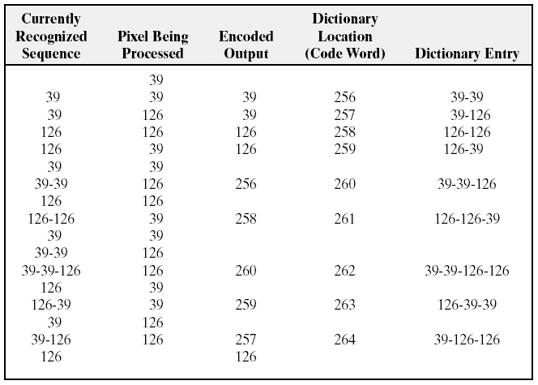
8.2.4 LZW Coding
TABLE 8.7
LZW coding example.

Slide 25
8.2.5 Run-Length Coding
BMP absolute coding mode options. In this mode, the first byte of the BMP pair is 0.
TABLE 8.8

Slide 27
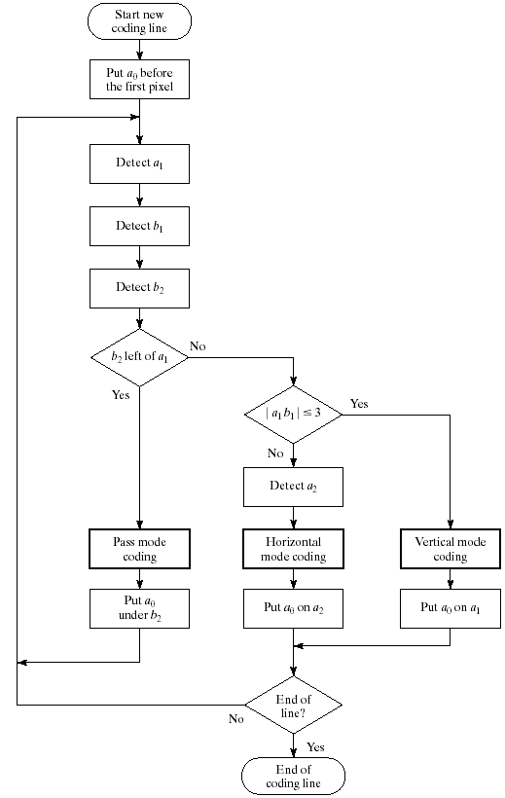
FIGURE 8.14
CCITT 2-D READ coding procedure. The notation |a₁b₁| denotes the absolute value of the distance between changing elements a₁ and b₁.

Slide 28
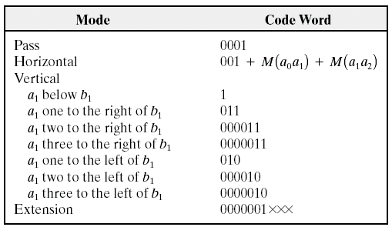
8.2.5 Run-Length Coding
CCITT two-dimensional code table
TABLE 8.9

Slide 29
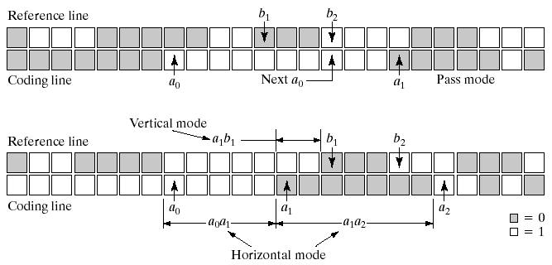
8.2.5 Run-Length Coding
Pass Mode
FIGURE 8.15
Horizontal and Vertical Mode

Slide 30
8.2.5 Run-Length Coding
FIGURE 8.16 A binary scan of a book page: (a) scaled to show the general page content; (b) scaled to show the binary pixels used in dithering.

Slide 31
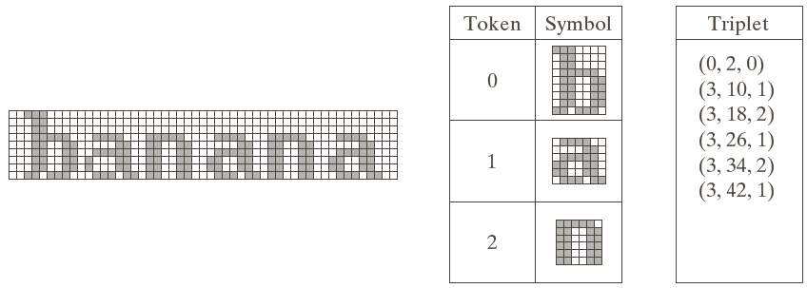
8.2.6 Symbol-Based Coding
Triplets to Locate the Symbols
Symbol Dictionary
Bi-Level Document
FIGURE 8.17

Slide 32
8.2.6 Symbol-Based Coding
Lossless Compression and Reconstruction
Perceptually Lossless
Scaled Difference
FIGURE 8.18 JBIG2 compression comparison.

Slide 33
8.2.7 Bit-Plane Coding
JBIG2 lossless coding results for the binary and Gray-coded bit planes of Fig. 8.19(a)
TABLE 8.10

Slide 34
FIGURE 8.19
(a) A 256-bit monochrome image. (b)-(c) The four most significant binary and Gray-coded bit planes of the image in (a).

Slide 35
FIGURE 8.20
(a)-(h) The four least significant binary (left column) and Gray-coded (right column) bit planes of the image in Fig. 8.19(a).

Slide 36
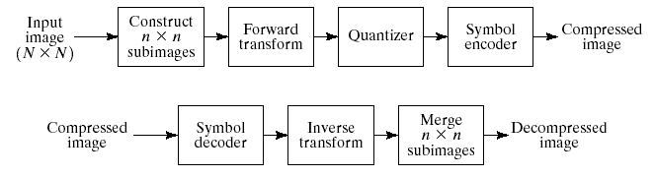
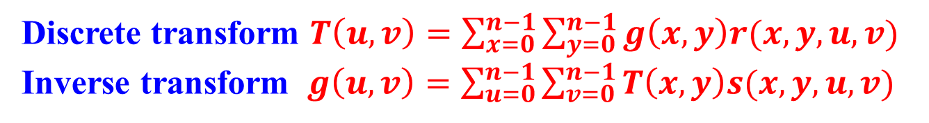
8.2.8 Block Transform Coding
A Transform System
Encoder
FIGURE 8.21
Decoder
Discrete transform $T\left(u,v\right)=\sum_{x=0}^{n−1}{\sum_{y=0}^{n−1}{g\left(x,y\right)r(x,y,u,v)}}$
Inverse transform $g\left(u,v\right)=\sum_{u=0}^{n−1}{\sum_{v=0}^{n−1}{T\left(x,y\right)s(x,y,u,v)}}$

Slide 37
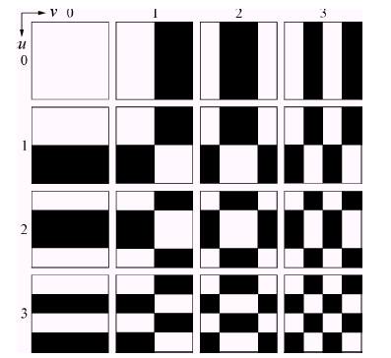
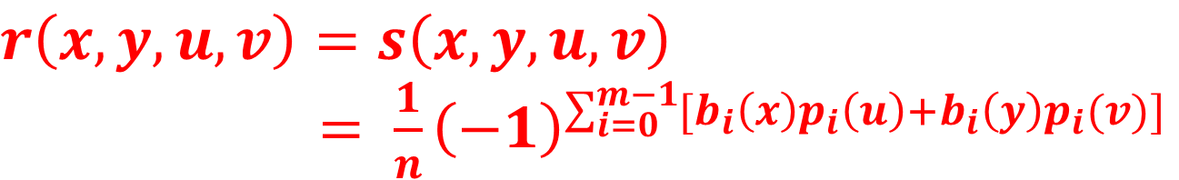
8.2.8 Block Transform Coding
$$r\left(x,y,u,v\right)=s\left(x,y,u,v\right)$$
$= \frac{1}{n}{\left(−1\right)}^{\sum_{i=0}^{m−1}{[b_{i}\left(x\right)p_{i}\left(u\right)+b_{i}\left(y\right)p_{i}(v)]}}$
FIGURE 8.22
Walsh-Hadamard basis functions for n = 4. The origin of each block is at its top left.

Slide 38
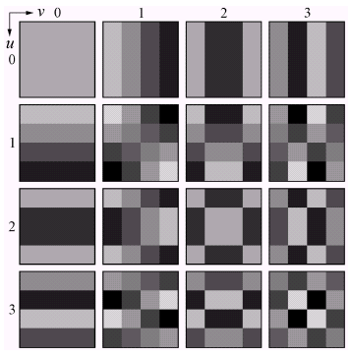
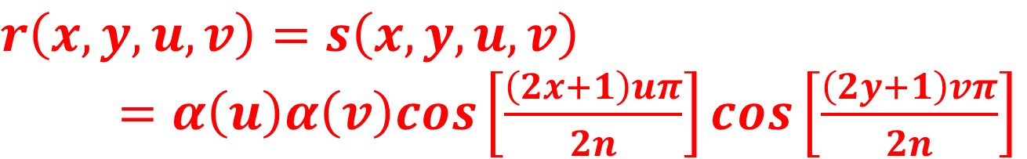
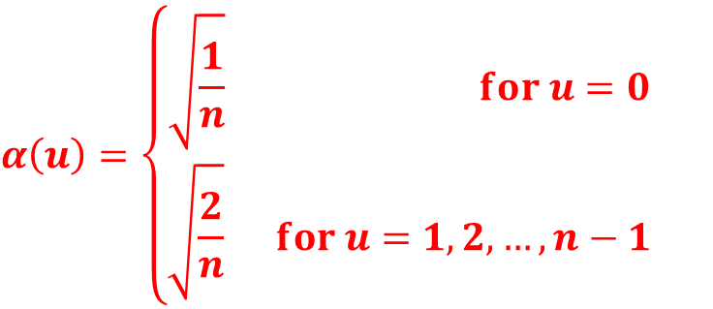
8.2.8 Block Transform Coding
$$r\left(x,y,u,v\right)=s\left(x,y,u,v\right)$$
$=α\left(u\right)α\left(v\right)cos\left[\frac{\left(2x+1\right)uπ}{2n}\right]cos\left[\frac{\left(2y+1\right)vπ}{2n}\right]$
$$α\left(u\right)=\left\{\begin{aligned}\sqrt{\frac{1}{n}} for u=0 \\ \sqrt{\frac{2}{n}} for u=1,2,…,n−1\end{aligned}\right.$$
FIGURE 8.23
Discrete-cosine basis functions for n = 4. The origin of each block is at its top left.

Slide 39
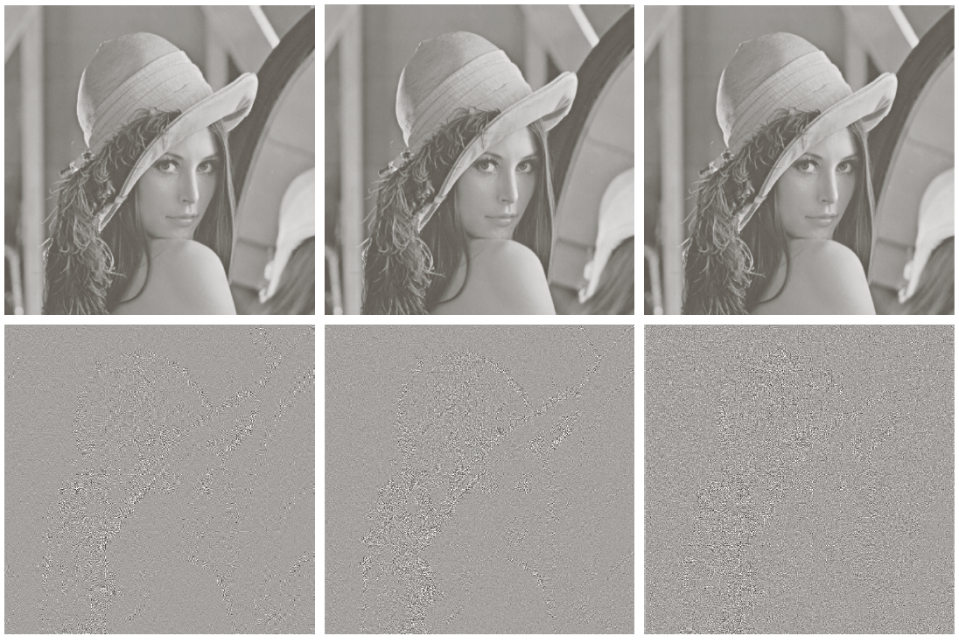
8.2.8 Block Transform Coding
Walsh-Hadamard
Cosine Transform
Fourier
Truncating 50% of the coefficients
Scaled Error
FIGURE 8.24 Approximations of Fig. 8.9(a).

Slide 40
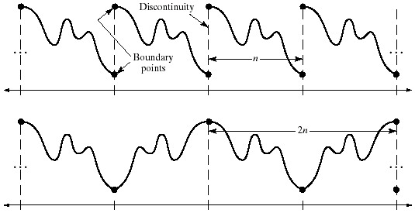
8.2.8 Block Transform Coding
FIGURE 8.25
The periodicity implicit in the 1-D (a) DFT and (b) DCT.

Slide 41
8.2.8 Block Transform Coding
FIGURE 8.26
Reconstruction error versus subimage size.

Slide 42
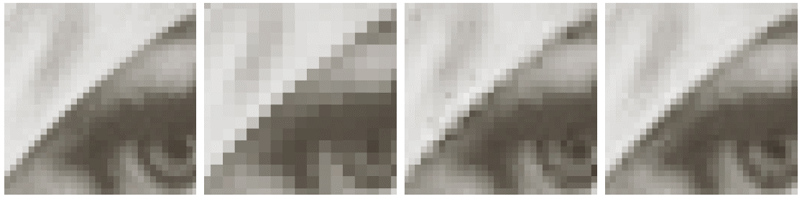
8.2.8 Block Transform Coding
FIGURE 8.27
Approximations of Fig. 8.27(a) using 25% of the DCT coefficients and (b) 2×2 subimages, (c) 4×4 subimages, and (d) 8×8 subimages. The original image in (a) is a zoomed section of Fig. 8.9(a).

Slide 43
8.2.8 Block Transform Coding
rms=4.5
FIGURE 8.28
Approximations of Fig. 8.9(a) using 12.5% of the 8×8 DCT coefficients: (a)-(b)threshold coding results; (c)-(d)zonal coding results. The difference images are scaled by 4.
rms=6.5

Slide 44
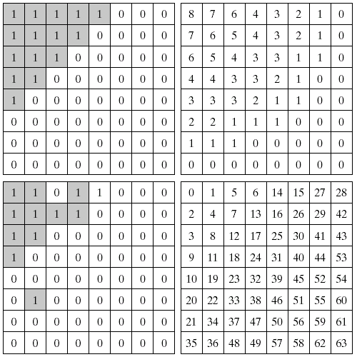
8.2.8 Block Transform Coding
Zonal Mask
Zonal Bit Allocation
Thresholded Coefficient Ordering Sequence
Threshold Mask
FIGURE 8.29

Slide 45
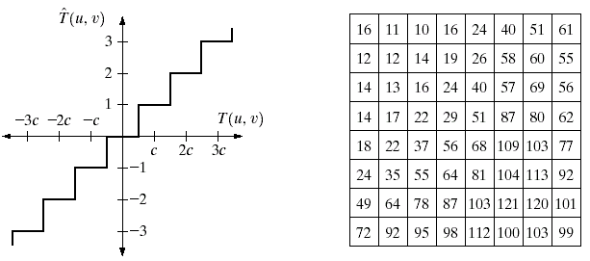
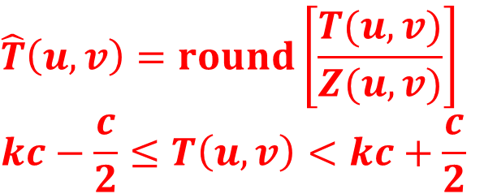
8.2.8 Block Transform Coding
Threshold Coding Quantization
Typical Normalization Matrix
$$\hat{T}\left(u,v\right)=round\left[\frac{T(u,v)}{Z(u,v)}\right]$$
$$kc−\frac{c}{2}≤T\left(u,v\right)<kc+\frac{c}{2}$$

Slide 46
8.2.8 Block Transform Coding
Z
2Z
4Z
8Z
16Z
32Z
FIGURE 8.31 Approximations of Fig. 8.9(a) using DCT and normalization array of Fig. 8.30(b).

Slide 47
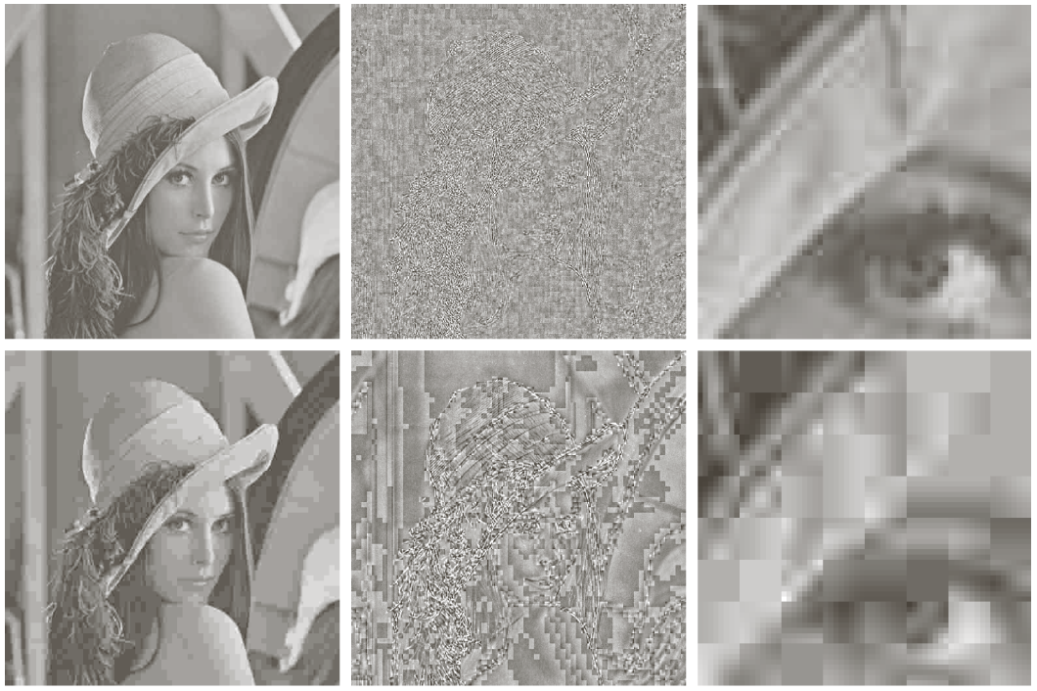
8.2.8 Block Transform Coding
rms:5.4
25:1
rms:10.7
52:1
FIGURE 8.32 Two JPEG approximations of Fig. 8.9(a). Each row contains a result after compression and reconstruction, the scaled difference between the result and the original image, and a zoomed portion of the reconstructed image.

Slide 48
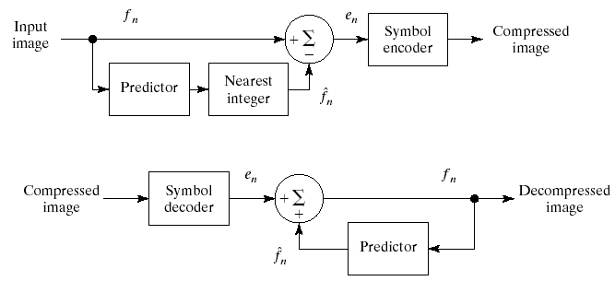
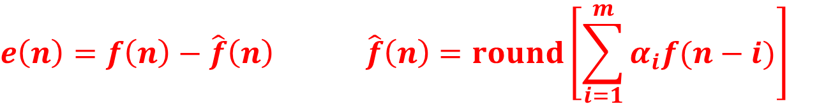
8.2.9 Predictive Coding
Lossless Predictive Coding Model
Encoder
Decoder
FIGURE 8.33
$$e\left(n\right)=f\left(n\right)−\hat{f}\left(n\right) \hat{f}\left(n\right)=round\left[\sum_{i=1}^{m}{α_{i}f(n−i)}\right]$$

Slide 49
8.2.9 Predictive Coding
$$\hat{f}\left(x,y\right)=round[αf(x,y−1)]$$
FIGURE 8.34
(a) A view of the Earth from an orbiting space shuttle. (b) The intensity histogram of (a). (c) The predictive error image resulting from Eq. (8.2-34). (d) A histogram of the prediction error.

Slide 50
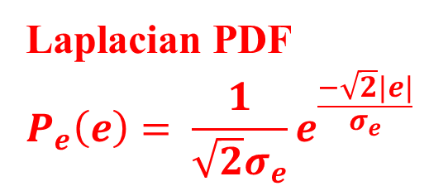
8.2.9 Predictive Coding
$$\hat{f}\left(x,y,t\right)=round[αf(x,y,t−1)]$$
Laplacian PDF
$$P_{e}\left(e\right)= \frac{1}{\sqrt{2}σ_{e}}e^{\frac{−\sqrt{2}|e|}{σ_{e}}}$$
FIGURE 8.35
(a) And (b) Two views of Earth from an orbiting space shuttle video. (c) The predictive error image resulting from Eq. (8.2-36). (d) A histogram of the prediction error.

Slide 51
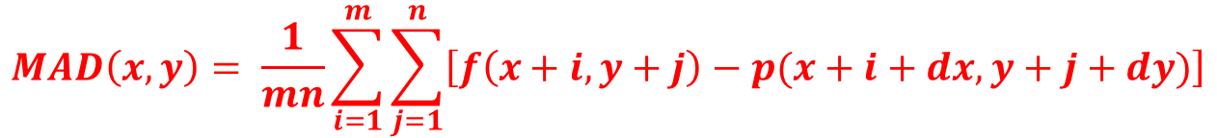
8.2.9 Predictive Coding
FIGURE 8.36
Macroblock motion specification.
Mean Absolute Distortion
$$MAD\left(x,y\right)= \frac{1}{mn}\sum_{i=1}^{m}{\sum_{j=1}^{n}{\left[f\left(x+i,y+j\right)−p(x+i+dx,y+j+dy)\right]}}$$

Slide 52
8.2.9 Predictive Coding
FIGURE 8.37 (a) And (b) Two views of Earth that are thirteen frames apart in an orbiting space shuttle video. (c) A prediction error image without motion compensation. (d) The prediction residual with motion compensation. (e) The motion vectors associated with (d). The white dots in (d) represent the arrow heads of the motion vectors that are depicted.

Slide 53
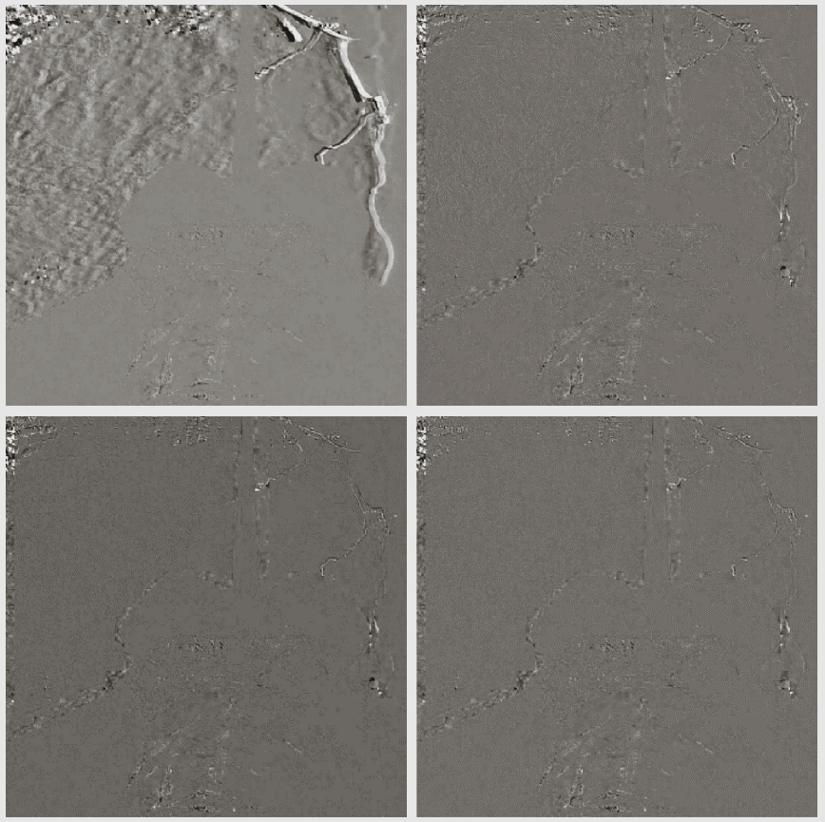
8.2.9 Predictive Coding
FIGURE 8.38
Sub-pixel motion compensated prediction residuals: (a) without motion compensation; (b) single pixel precision; (c) ½ pixel precision; (d) ¼ pixel precision.

Slide 54
8.2.9 Predictive Coding
Predictive Coding in Video Compression Standards

Slide 55
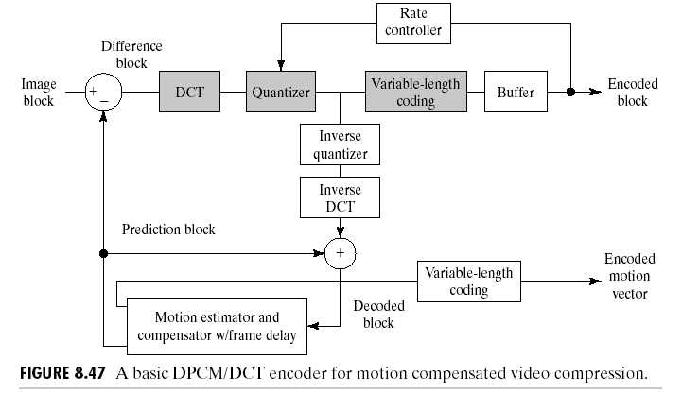
8.2.9 Predictive Coding
FIGURE 8.39
A typical compensated video encoder.

Slide 56
8.2.9 Predictive Coding
FIGURE 8.40
Fifteen frames from an 1829-frame, 1-minute NASA video.

Slide 57
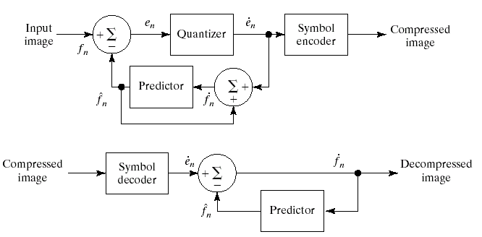
8.2.9 Predictive Coding
Lossless Predictive Coding Model
Encoder
FIGURE 8.41
Decoder

Slide 58
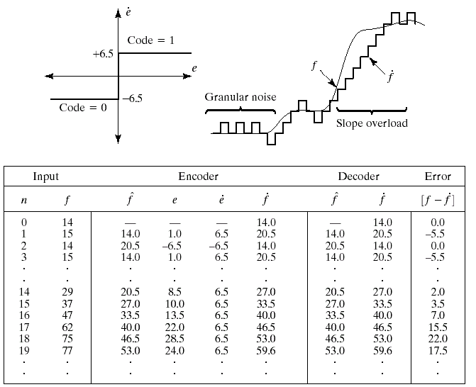
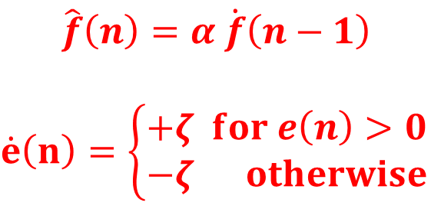
8.2.9 Predictive Coding
EXAMPLE: Delta Modulation
$$\hat{f}\left(n\right)=α \dot{f}\left(n−1\right)$$
$$\dot{e}\left(n\right)=\left\{\begin{aligned}+ζ for e\left(n\right)>0 \\ −ζ otherwise\end{aligned}\right.$$

Slide 59

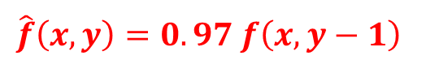
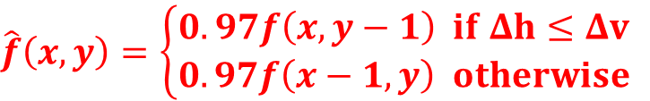
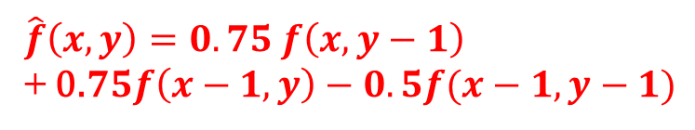
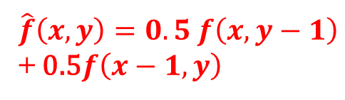
8.2.9 Predictive Coding
$$\hat{f}\left(x,y\right)=0.5 f\left(x,y−1\right)$$
+ 0.5$f\left(x−1,y\right)$
$$\hat{f}\left(x,y\right)=0.97 f\left(x,y−1\right)$$
$$\hat{f}\left(x,y\right)=0.75 f\left(x,y−1\right)$$
+ 0.$75f\left(x−1,y\right)−0.5f(x−1,y−1)$
$$\hat{f}\left(x,y\right)=\left\{\begin{aligned}0.97f\left(x,y−1\right) if Δh≤Δv \\ 0.97f\left(x−1,y\right) otherwise\end{aligned}\right.$$

Slide 60
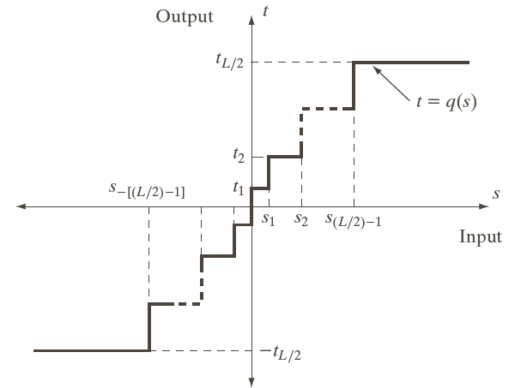
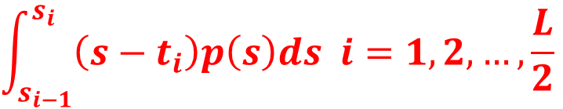
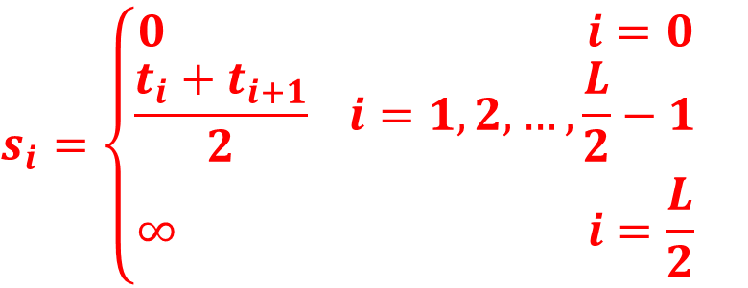
8.2.9 Predictive Coding
A typical quantization function
$$\int_{s_{i−1}}^{s_{i}}{\left(s−t_{i}\right)p\left(s\right)ds i=1,2,…,\frac{L}{2}}$$
$$s_{i}=\left\{\begin{aligned}0 i=0 \\ \frac{t_{i}+t_{i+1}}{2} i=1,2,…,\frac{L}{2}−1 \\ ∞ i=\frac{L}{2}\end{aligned}\right.$$
FIGURE 8.44

Slide 61
8.2.9 Predictive Coding
Lloyd-Max quantizers for a Laplacian probability density function of unit variance

Slide 62
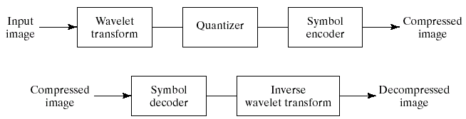
8.2.10 Wavelet Coding
Wavelet Coding System
Encoder
FIGURE 8.45
Decoder

Slide 63
8.2.10 Wavelet Coding
Haar
Daubechies
Symlets
Biorthogonal

Slide 64
8.2.10 Wavelet Coding
Wavelet transform filter taps and zeroed coefficients when truncating the transforms in Fig. 8.46 below 1.5

Slide 65

8.2.10 Wavelet Coding
Decomposition level impact on wavelet coding the 512×512 image of Fig. 8.23

Slide 66
8.2.10 Wavelet Coding
FIGURE 8.47
The impact of dead zone interval selection on wavelet coding.

Slide 67

8.2.10 Wavelet Coding
Impulse responses of the low and highpass analysis filters for an irreversible 9-7 wavelet transform.

Slide 68



8.2.10 Wavelet Coding
$$q_{b}\left(u,v\right)=$$
$$sign\left[a_{b}\left(u,v\right)\right]⋅floor\left[\frac{|a_{b}(u,v)|}{Δ_{b}}\right]$$
$$Δ_{b}=2^{R_{b}−ε_{b}}\left(1+\frac{μ_{b}}{2^{11}}\right)$$
FIGURE 8.48
JPEG 2000 two-scale wavelet transform tile-component coefficient notation and analysis gain.

Slide 69
8.2.10 Wavelet Coding
FIGURE 8.49
Four JPEG-2000 approximations of Fig. 8.9(a). Each row contains a result after compression and reconstruction, the scaled difference between the result and the original image, and a zoomed portion of the reconstructed image.

Slide 70

8.3 Digital Image Watermarking
FIGURE 8.50 A simple visible watermark: (a) watermark; (b) the watermarked image; and (c) the difference between the watermarked image and the original.
$$f_{w}=\left(1−α\right)f+αw$$

Slide 71

8.3 Digital Image Watermarking
FIGURE 8.51
A simple invisible watermark: (a) watermark; (b) the extracted watermark; (c) the watermarked image after high quality JPEG compression and decompression; and (d) the extracted watermark from (c).

Slide 72

8.3 Digital Image Watermarking
Typical Image Watermarking System
Encoder
FIGURE 8.52
Decoder

Slide 73
8.3 Digital Image Watermarking
FIGURE 8.53
(a) And (c) Two watermarked versions of Fig. 8.9(a); (b) and (d) the differences between the watermarked versions and the unmarked image. These two images show the intensity contribution of the pseudo-random watermarks on the original image.

Slide 74
8.3 Digital Image Watermarking
JPEG rm error of
7 intensity levels
JPEG rm error of
10 intensity levels
Smoothing by
spatial filtering
FIGURE 8.54
Attacks on the watermarked image in Fig. 8.53(a).
Gaussian noise
Histogram equalization
Rotation

Slide 75









智能视觉理解
实验室

